Slide 1



FAKE NEWS DETECTION PROJECT
Submitted by:
Naina Joshi

Slide 2



Slide 3
Fake news is a form of news consisting of deliberate disinformation or hoaxes spread via traditional news media or online social media. Such news items may contain false and/or exaggerated claims, and may end up being vitalized by algorithms, and users may end up in a filter bubble.
Fake news is not a recent concept, but it is a commonly occurring phenomenon in current times. .With the widespread dissemination of information via digital media platforms, it is of utmost importance for individuals and societies to be able to judge the credibility of it.

Slide 4
Problem statement
The authenticity of Information has become a longstanding issue affecting businesses and society, both for printed and digital media. On social networks, the reach and effects of information spread occur at such a fast pace and so amplified that distorted, inaccurate, or false information acquires a tremendous potential to cause real-world impacts, within minutes, for millions of users.
The goal of this project is to use natural language processing techniques to automate stance detection, since it is not practical for humans to fact check every piece of information produced by the media

Slide 5
Exploratory Data Analysis
Checking shape of data.
Checking data types of each features using dataframe.info() function.
checking for null values in each column and treating them.
Pointing out irrelevant features in dataset like ‘id’,unnamed:0’.
Addition of new features to check the length of headline and news before and after preprocessing.
Cleaning the raw data-It involves deletion of words or special characters that do not add meaning to the text.

Slide 6
Exploratory Data Analysis
Important cleaning steps are:
Lowering case
Handling of special characters
Removal of stopwords
Handling of hyperlinks
Removing leading and trailing white space
Replacing urls with web address
Converted words to most suitable base form by using lemmatization

Slide 7
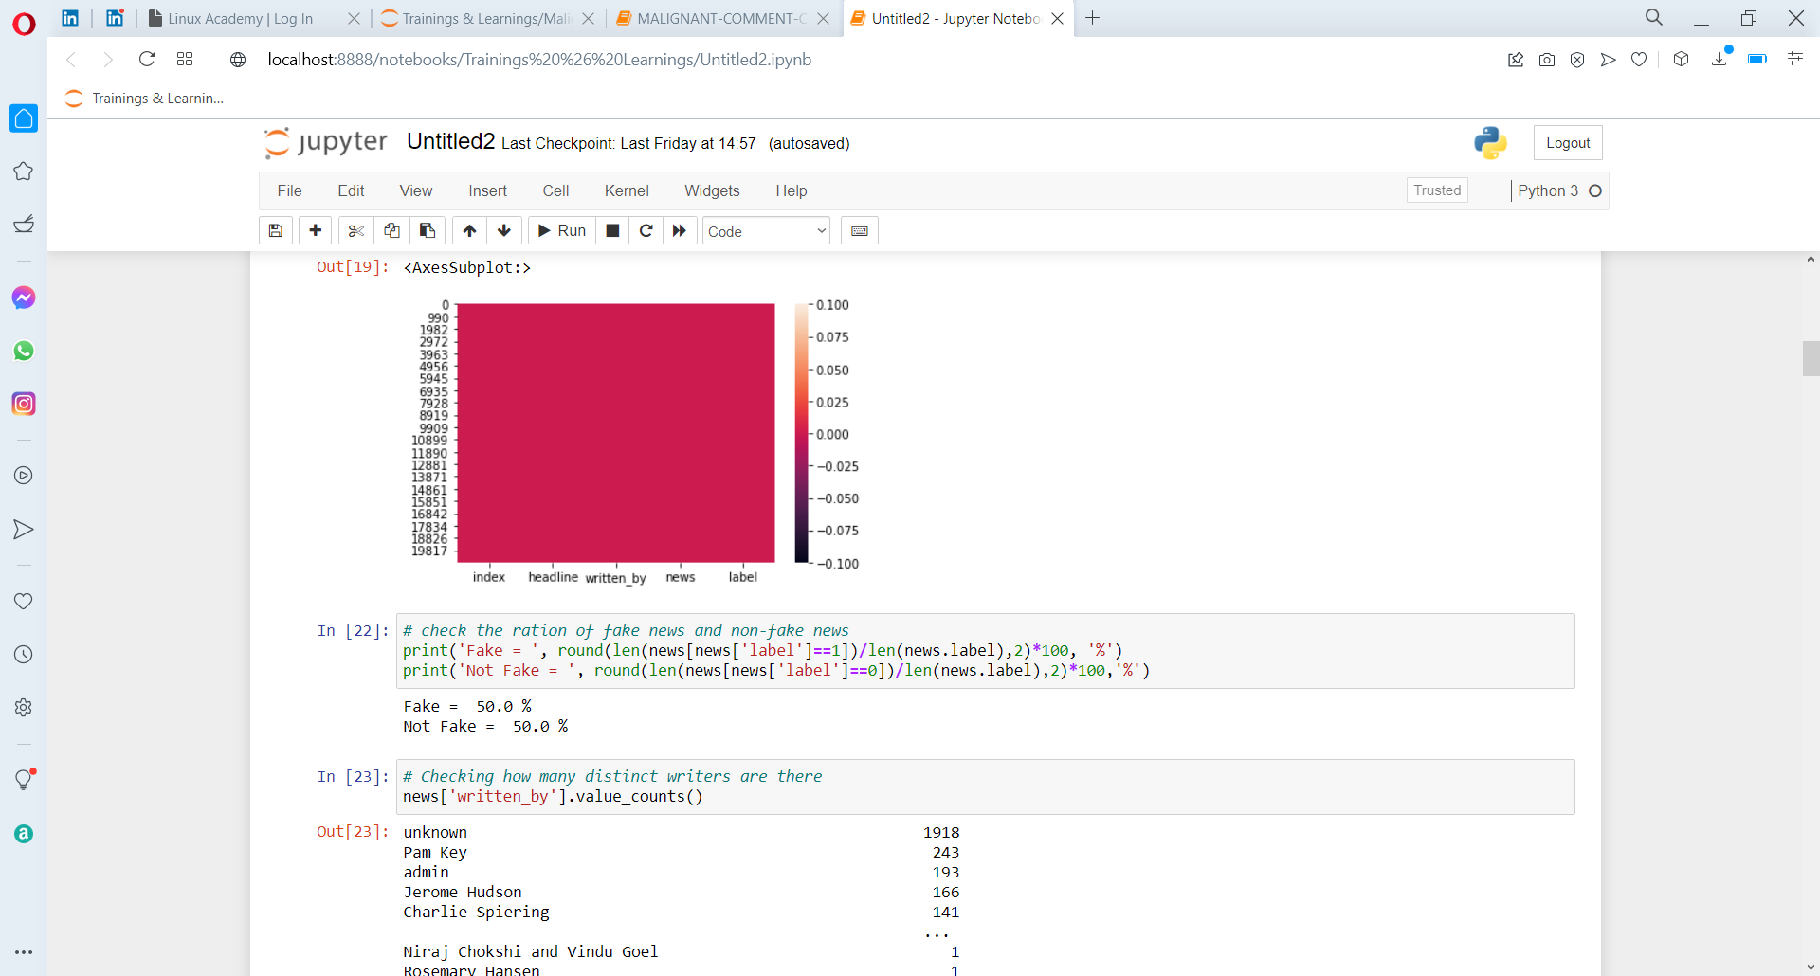
Checking distribution of fake and real news
We see that both news are equally distributed .ie dataset is balanced which is good as it will help our model to classify more accurately, so we should expect good accuracy score.

Slide 8
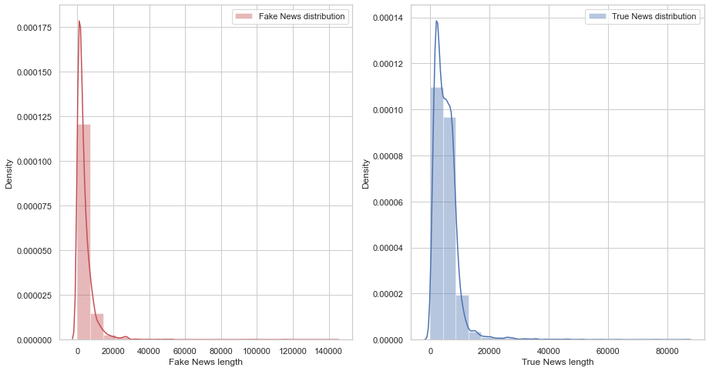
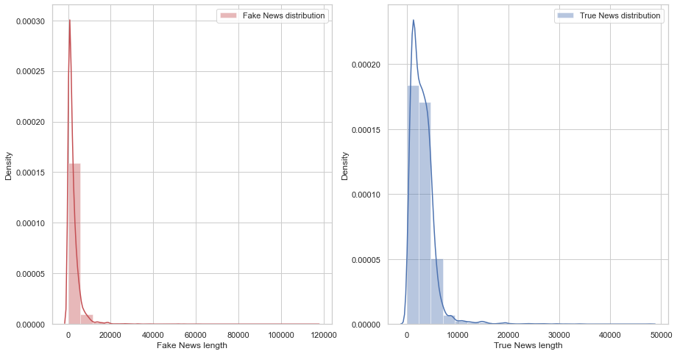
graph to show distribution of word count before cleaning and after cleaning
News Before cleaning
News After cleaning
To get better view of words contained in news. A word dictionary (wordcloud) was made showing the first 200 words highly occurred in fake and real news for both headline and news column.

Slide 9
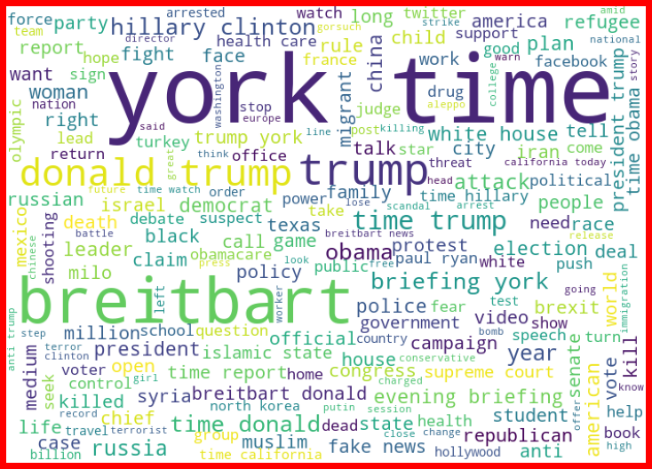
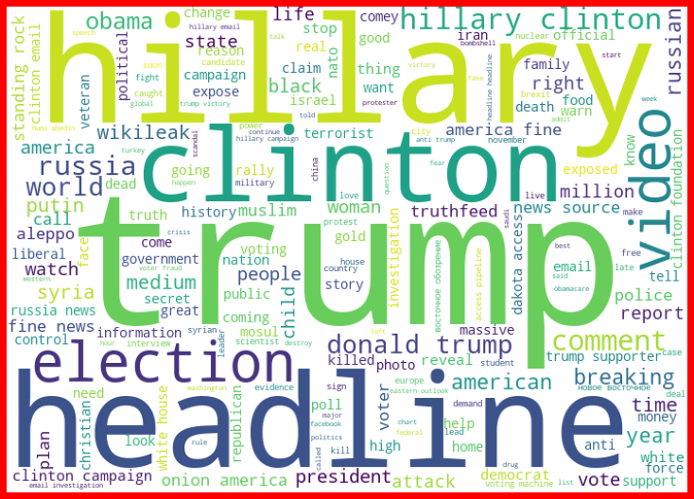
loud words in real News - Headline
loud words in fake News - Headline

Slide 10
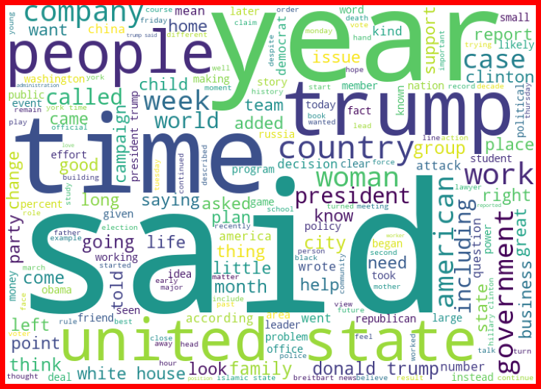
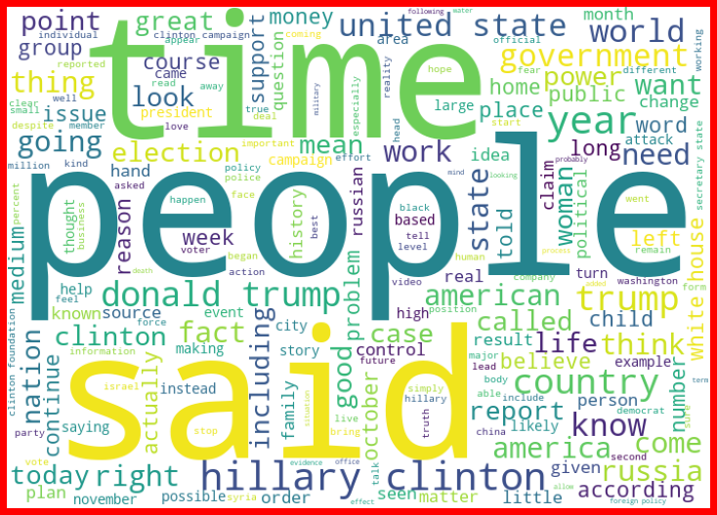
loud words in Not Fake News - Articles
loud words in Fake News - Articles

Slide 11
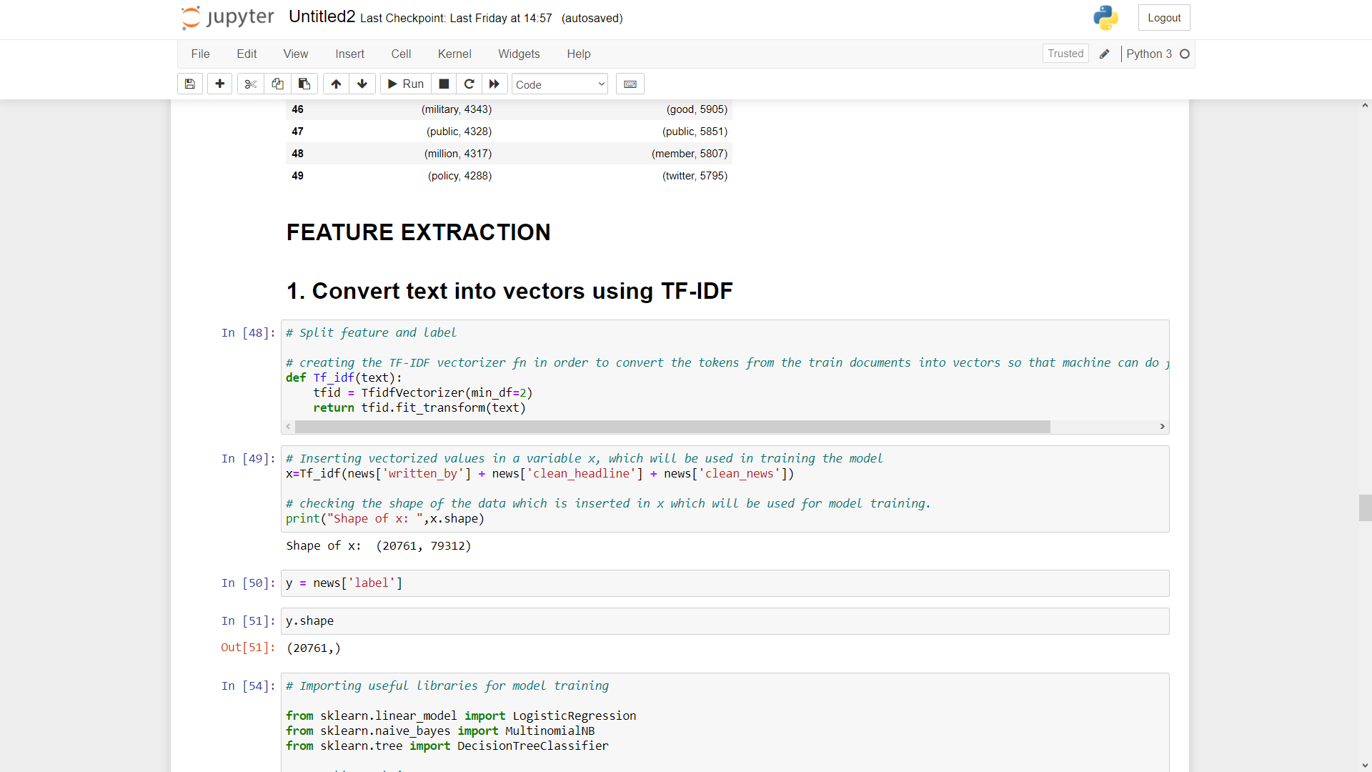
Training Classifier: We converted all the comment text into vectors , using TF-IDF. Then we have split features and label.

Slide 12
Model Building & Performance
it’s a binary classification type problem and below models were used:
LogisticRegression
DecisionTreeClassifier
RandomForestClassifier
AdaBoostClassifier
MultinomialNB
XGBoost Classifier

Slide 13
Evaluation Matrices
Accuracy - it determines how often a model predicts default and non default correctly. Confusion matrices :It gives direct comparisons of values like True Positives, False Positives, True Negatives and False Negatives
classification report :It displays the precision, recall, F1, and support scores for the model
F1 score - the F1-score, is a measure of a model's accuracy on a dataset. It is used to evaluate binary classification systems, which classify examples into 'positive' or 'negative'. AUC: It represents the degree or measure of separability. It tells how much the model is capable of distinguishing between
Log_Loss:For any given problem, a lower log loss value means better predictions

Slide 14
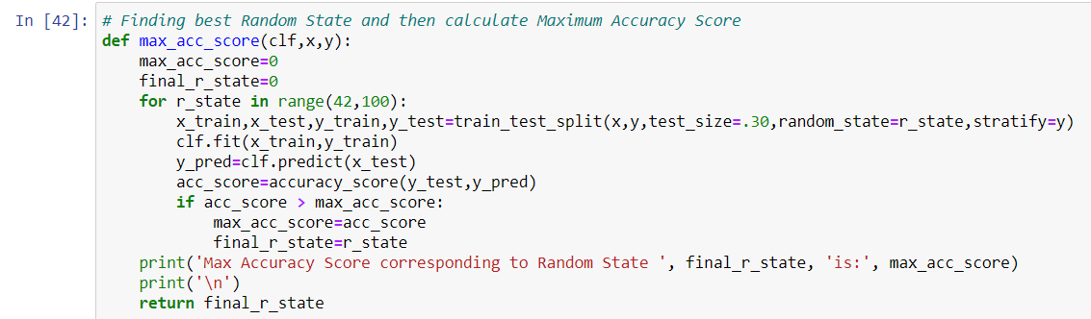
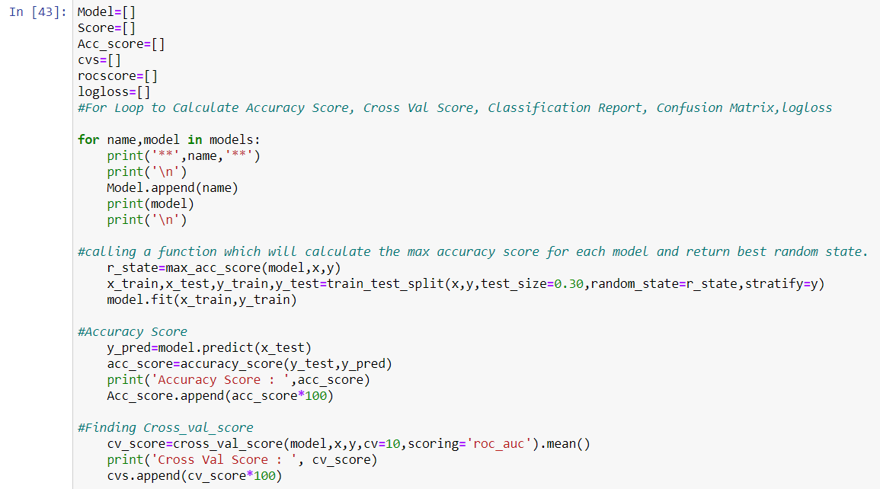
All algorithm by using for loop

Slide 15
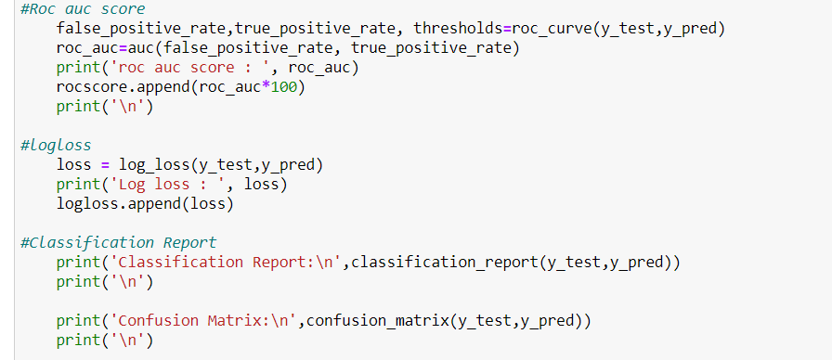
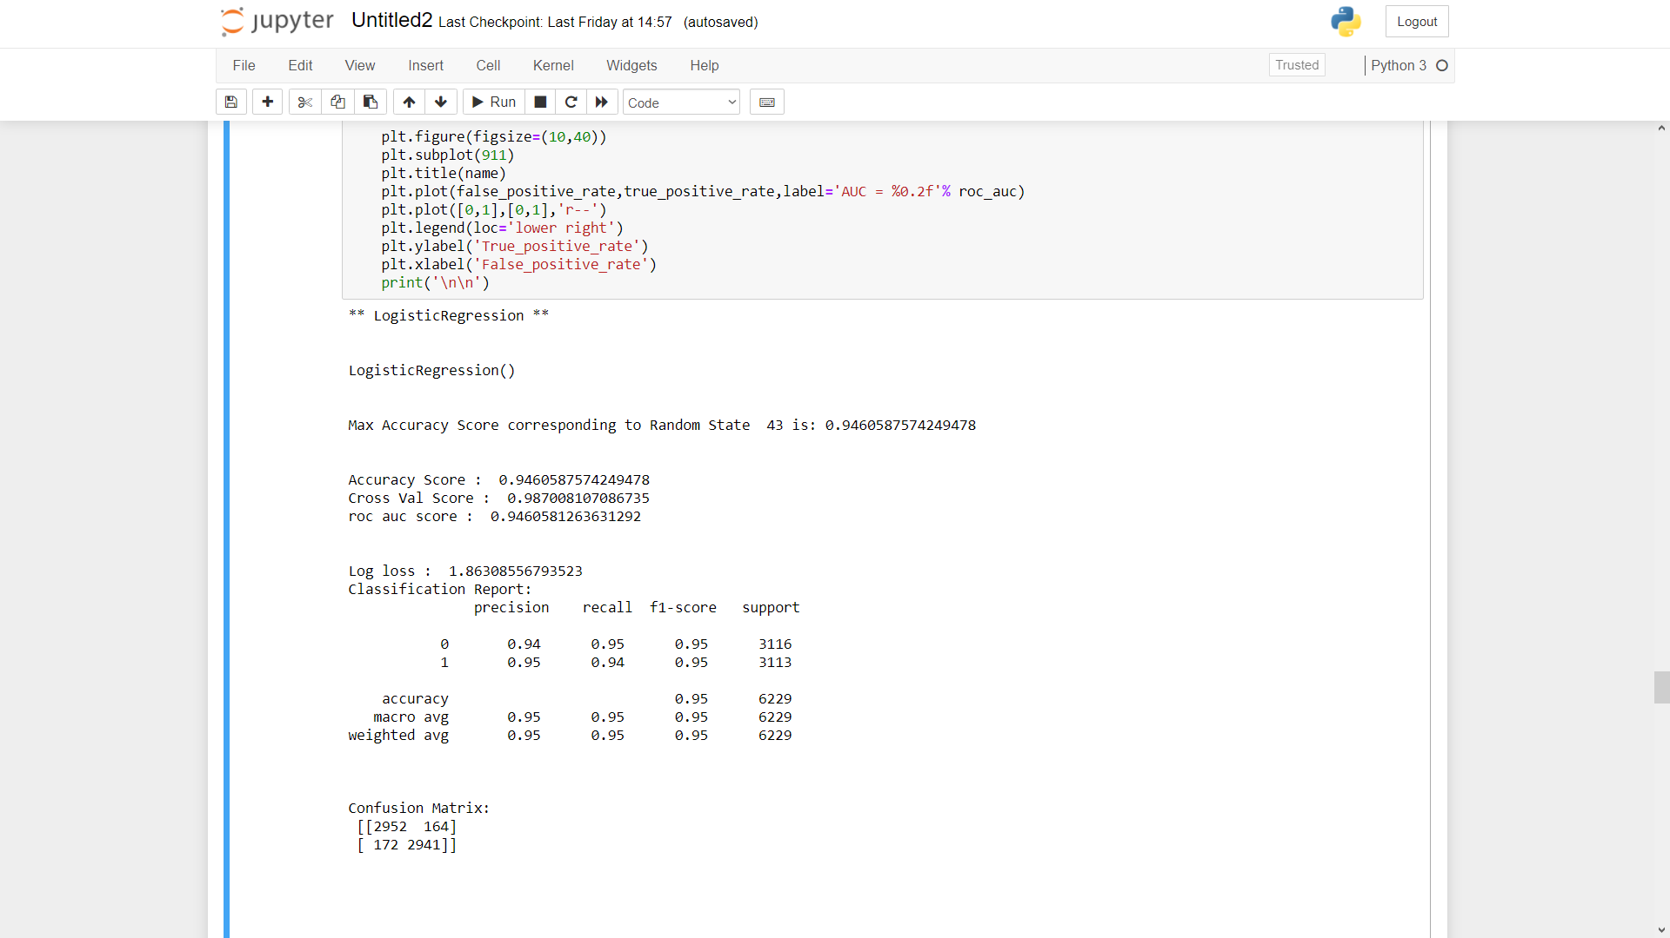
All algorithm by using for loop

Slide 16
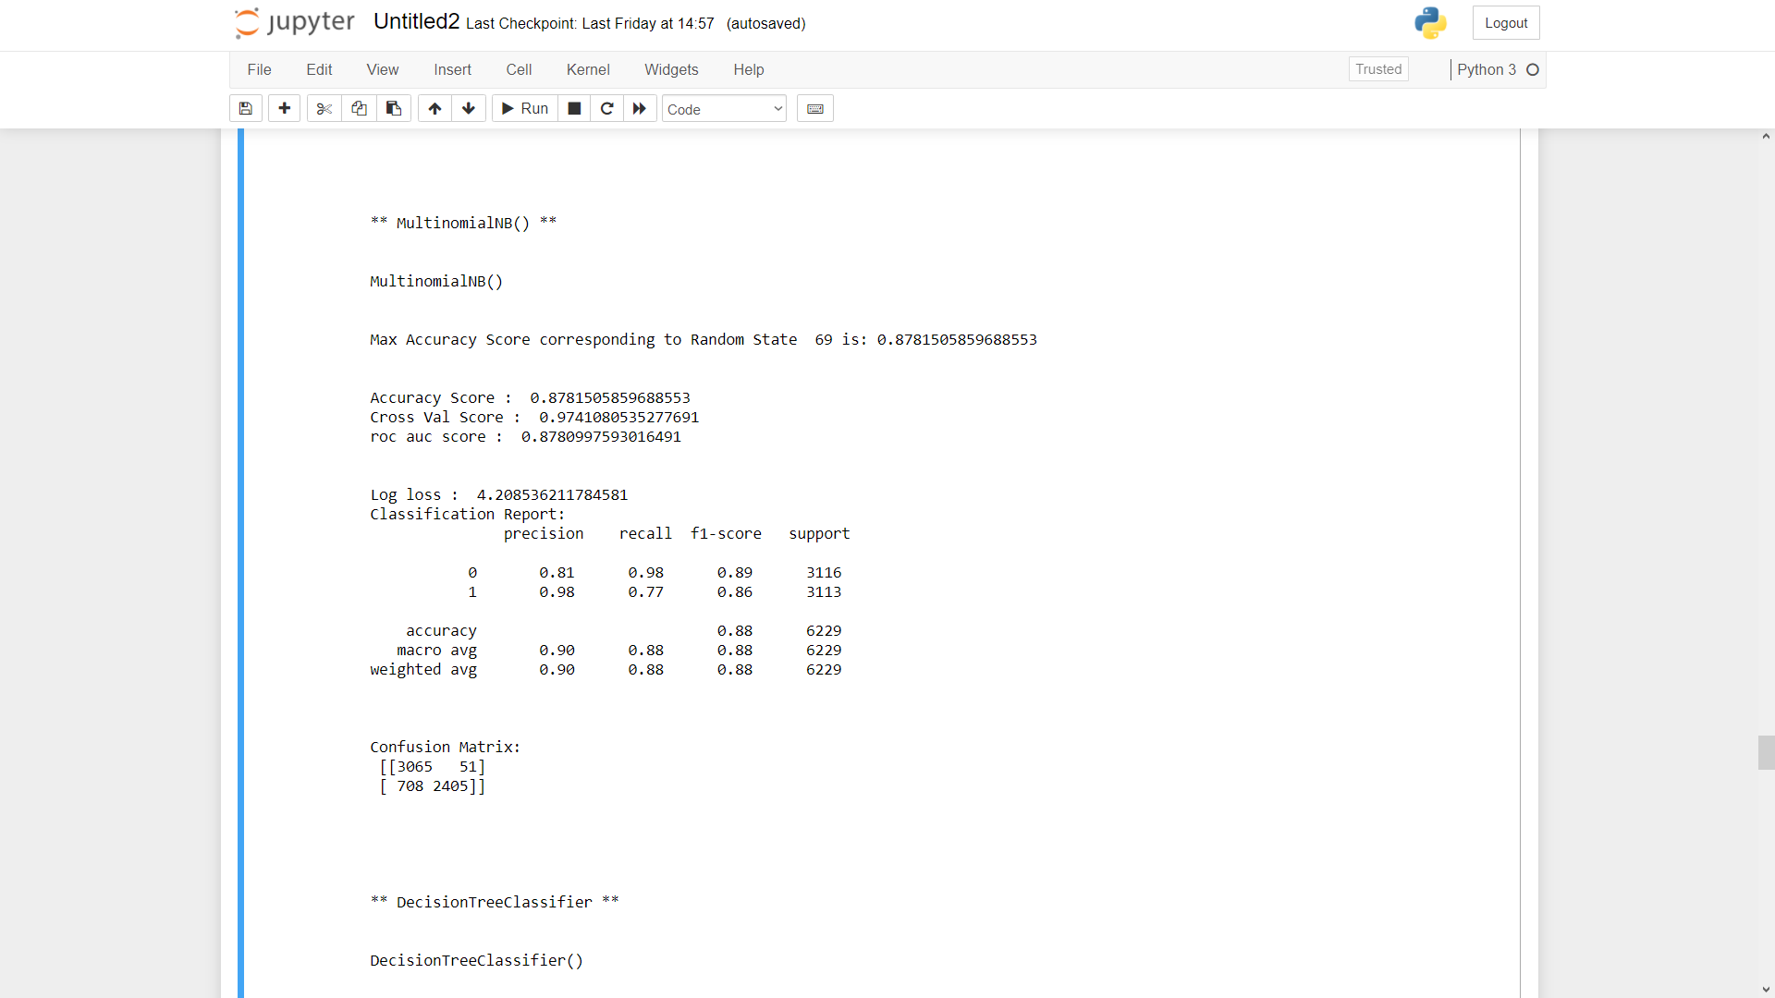
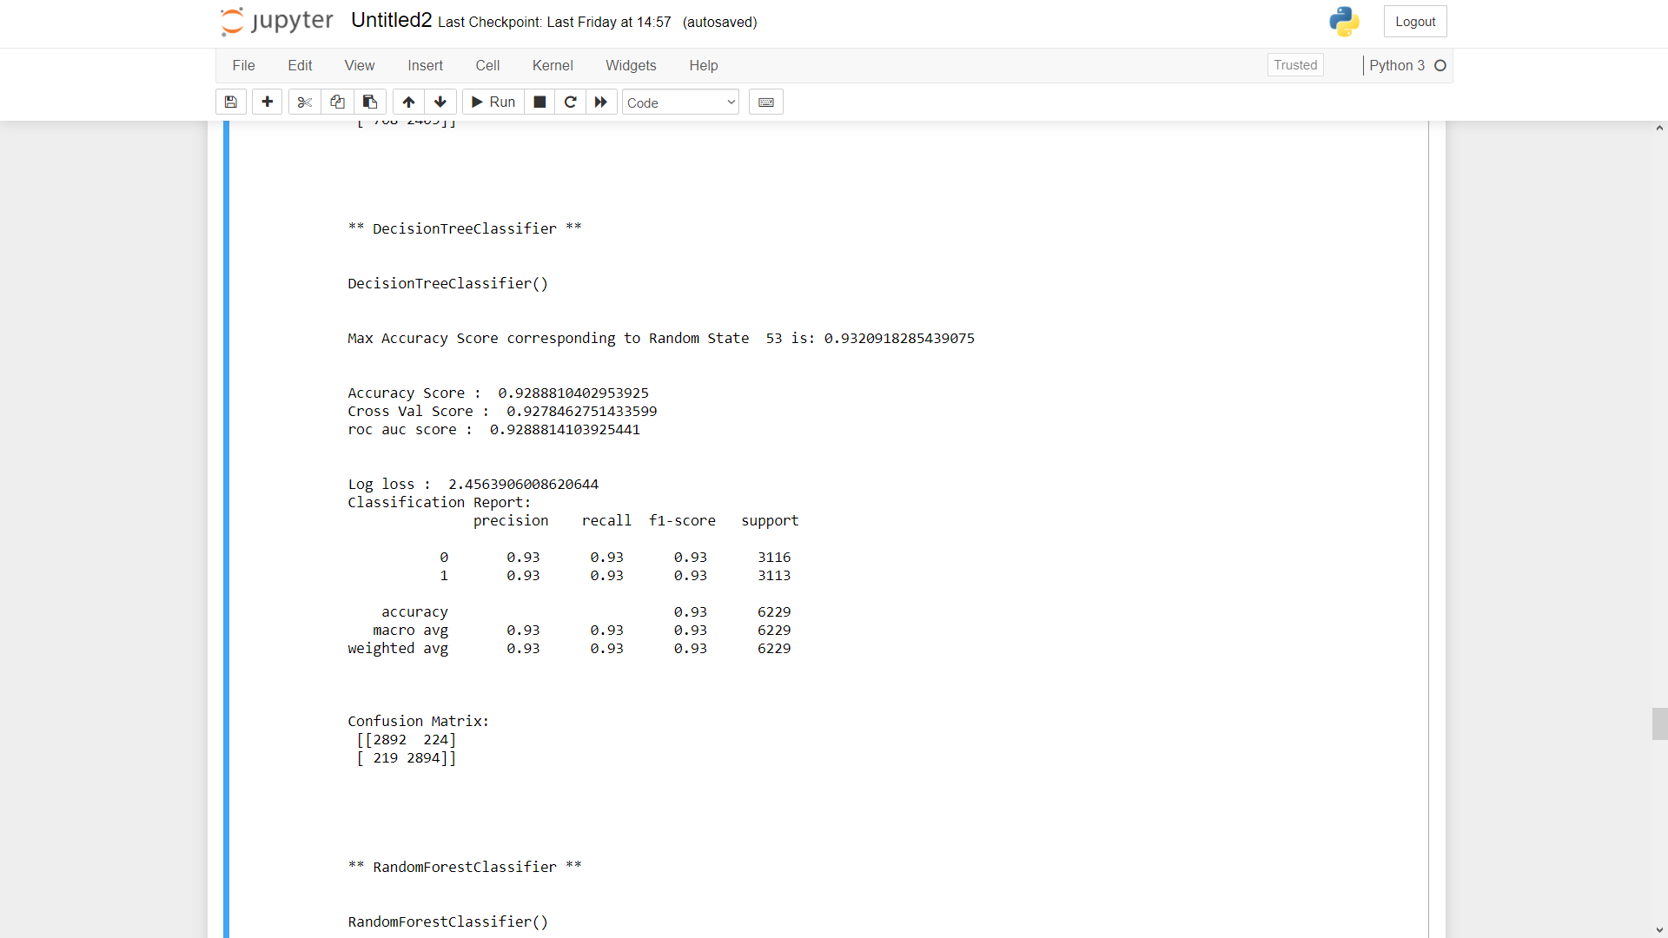
All algorithm by using for loop

Slide 17
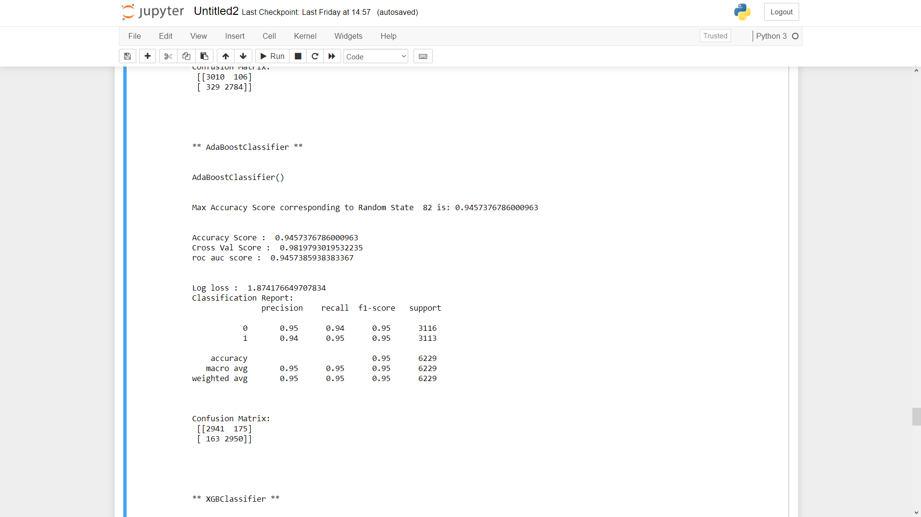
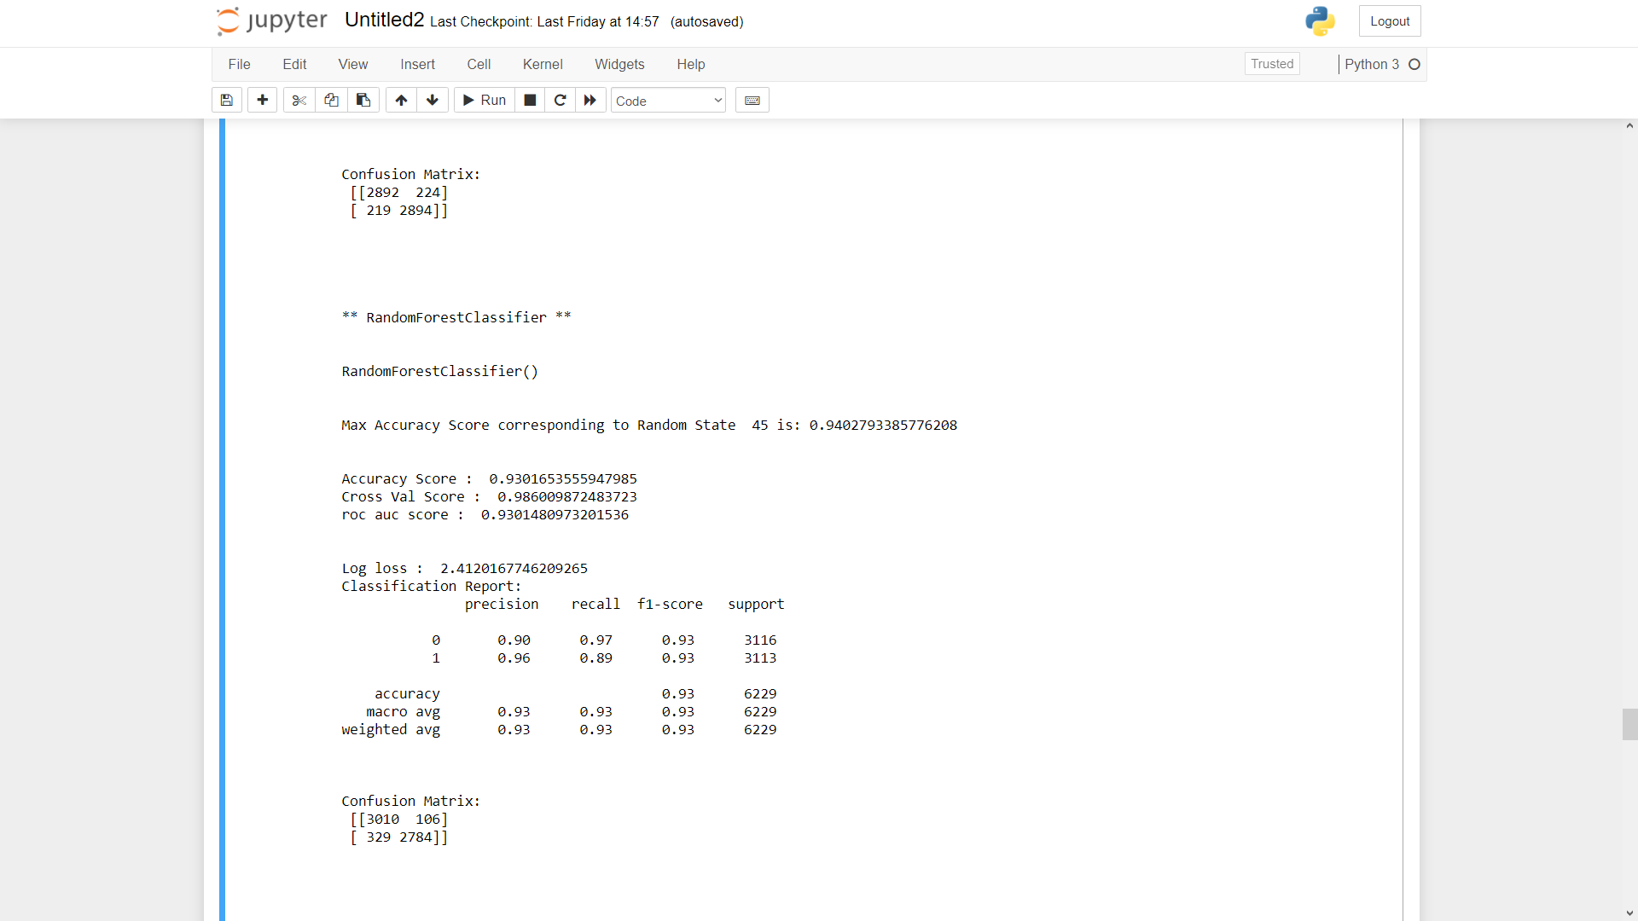
All algorithm by using for loop

Slide 18
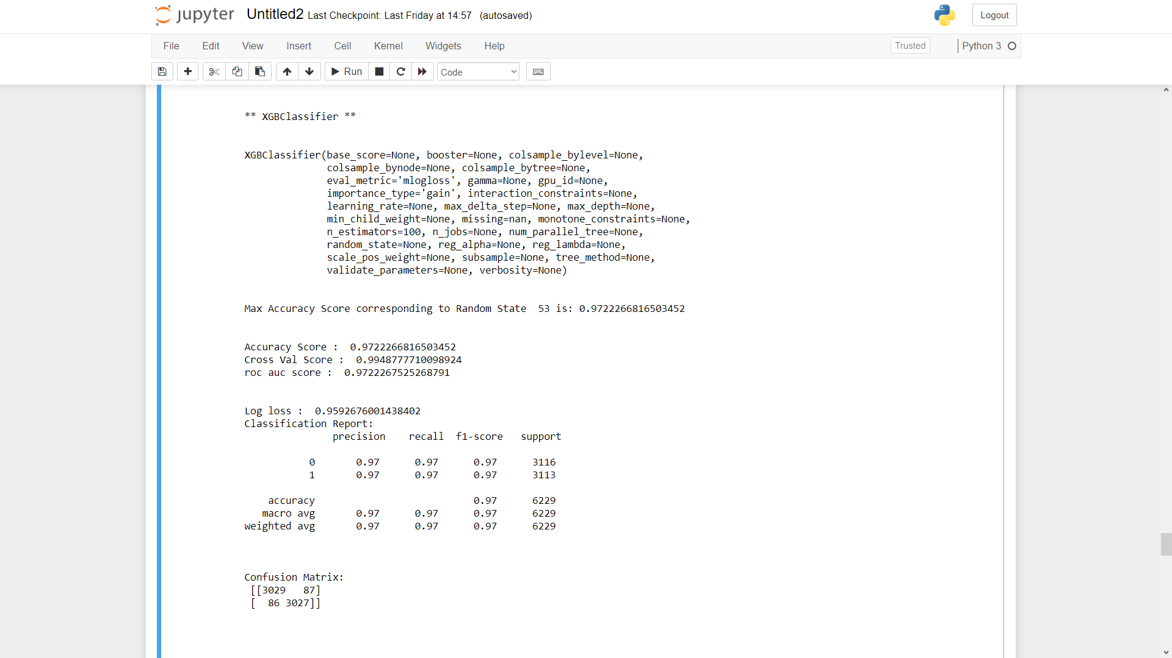
All algorithm by using for loop

Slide 19
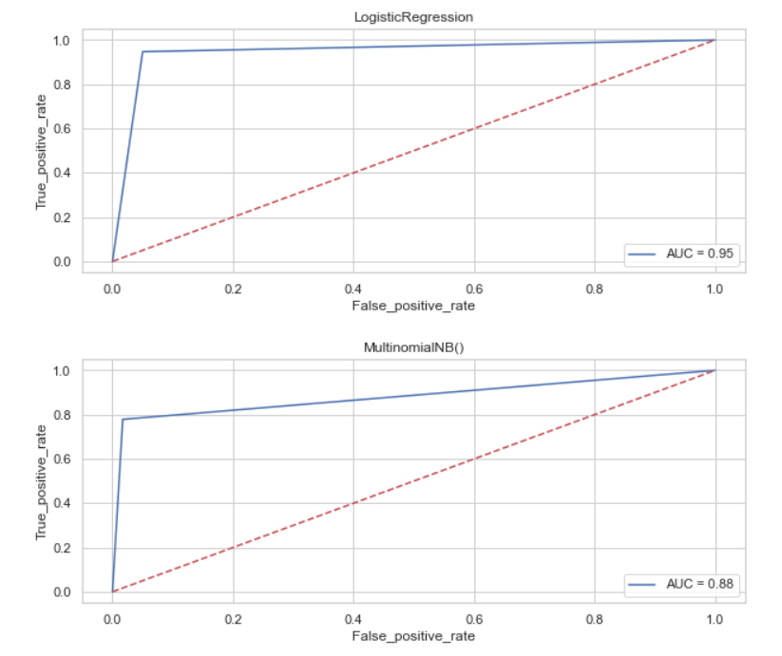
All algorithm by using for loop

Slide 20
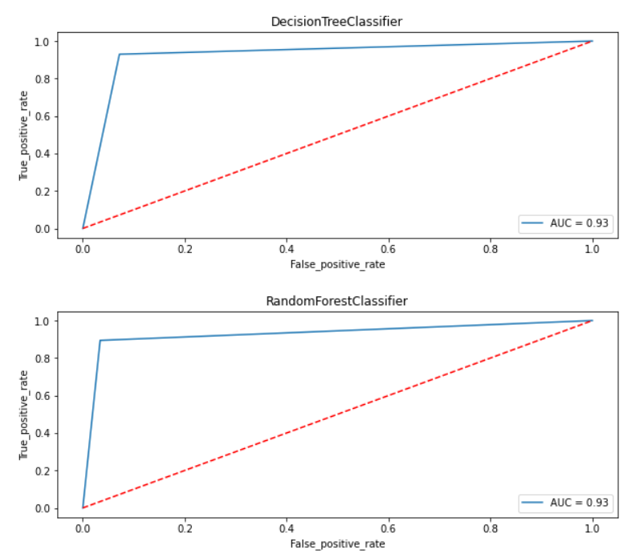
All algorithm by using for loop

Slide 21
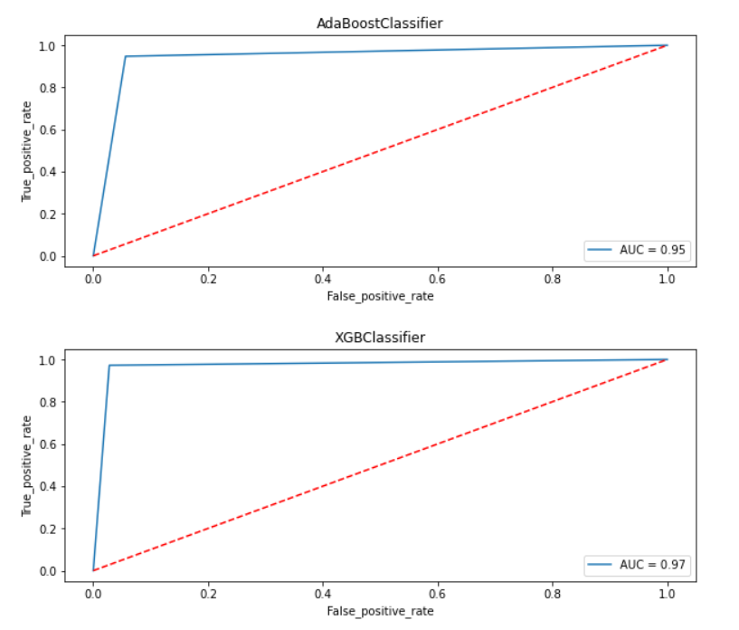
All algorithm by using for loop

Slide 22
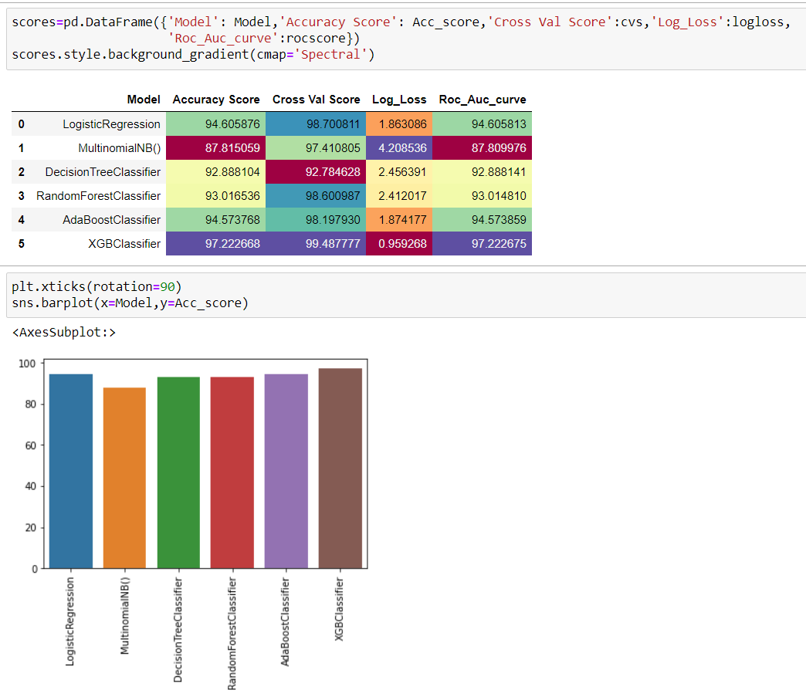
Result = pd.DataFrame({'Model': model_list, 'Accuracy_score': score, 'Cross_val_score':cvs,'Roc_auc_score': rocscore,'Log_Loss':logloss}) result
We choose XGBoost Classifier model as the final one, as it gives hightest accuracy score & also log_loss value is minimum which indicates better prediction.

Slide 23
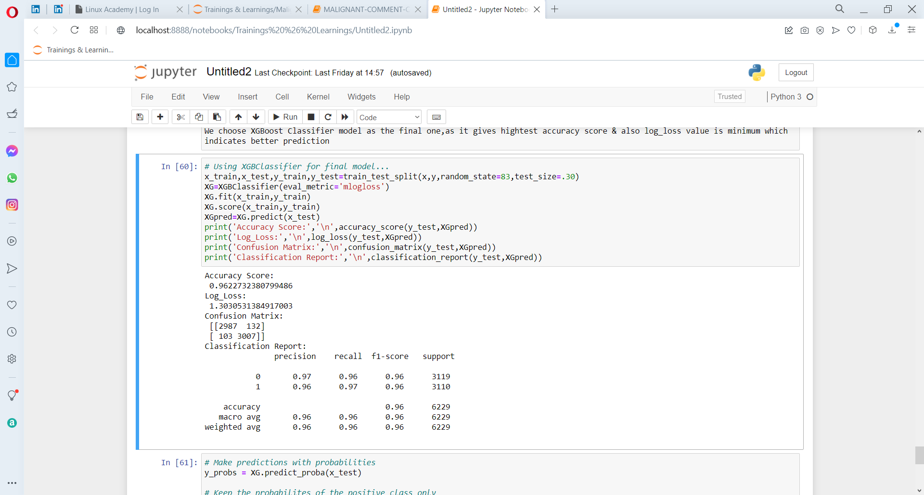
Final Model

Slide 24
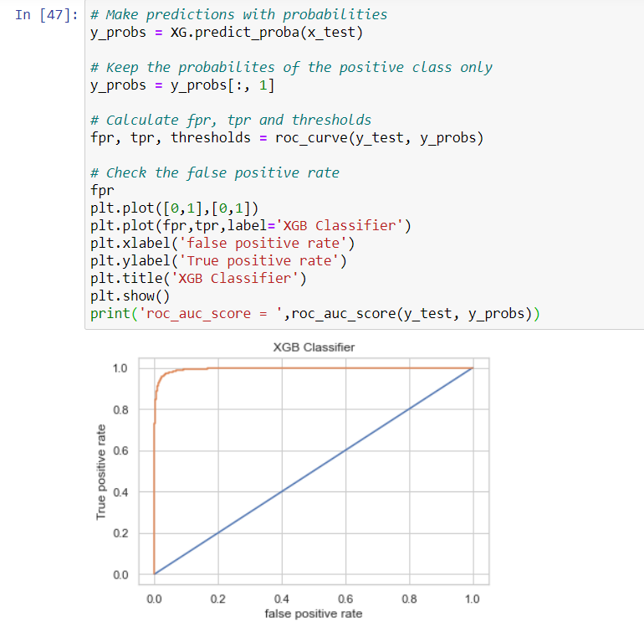
Final Model

Slide 25
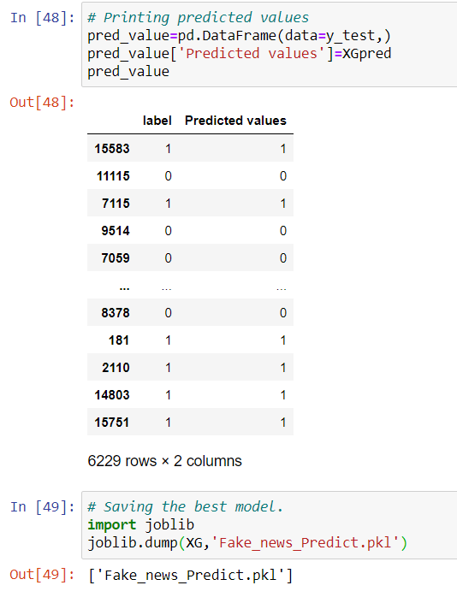

Saving the best model

Slide 26
Conclusion
Machine Learning Algorithms like XGBoost, Adaboost and Randomforest Classifier took an enormous amount of time to build the model. Using Hyper-parameter tuning for XGB would have resulted in some more accuracy.
The saved model now can help to give an estimate of probability about the type of news being fake or real.
It was overall a nice experience on working on a real time project of NLP domain to see how data science and machine learning is useful in this field.

